Slide 1







PUSHING EXOPLANET DETECTION CAPABILITY USING TUNABLE KERNEL-NULLING
Vincent Foriel1*, Frantz Martinache1, David Mary1
Marc-Antoine Martinod1, Nick Cvetojevic1, Romain Laugier2
1 Université Côte d'Azur, Observatoire de la Côte d'Azur, CNRS, Laboratoire Lagrange, France
2 KU Leuven university, Leuven, Belgium * vincent.foriel@oca.eu

Slide 2
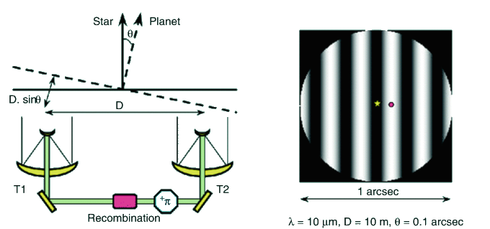
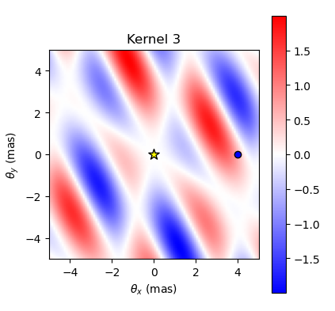
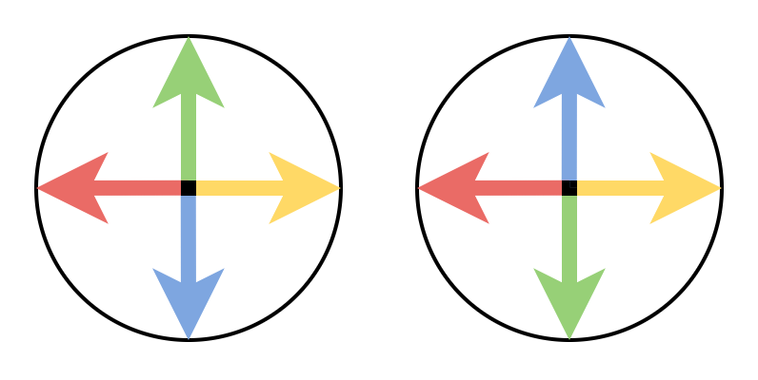
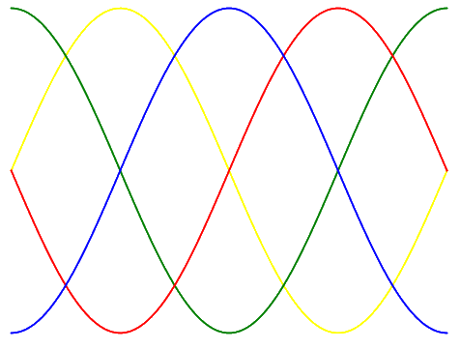
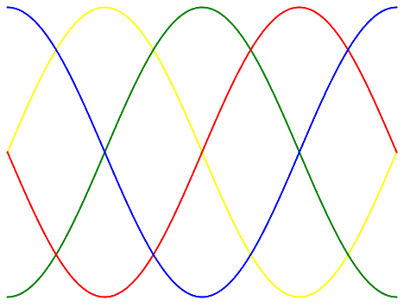
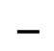
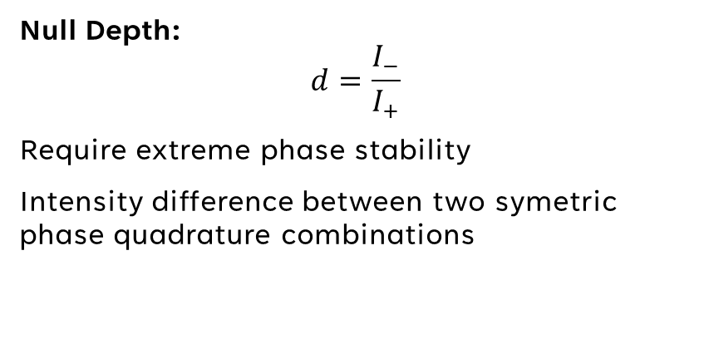
Nulling & Kernel-Nulling
📚 Bracewell et al. (1978)
📚 Martinache & Ireland (2018)
Null Depth:
$$d=\frac{I_{−}}{I_{+}}$$
Require extreme phase stability
Intensity difference between two symetric phase quadrature combinations
📚 D. Rouan (2022)
$$−$$

Slide 3
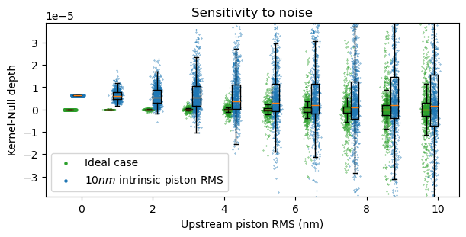
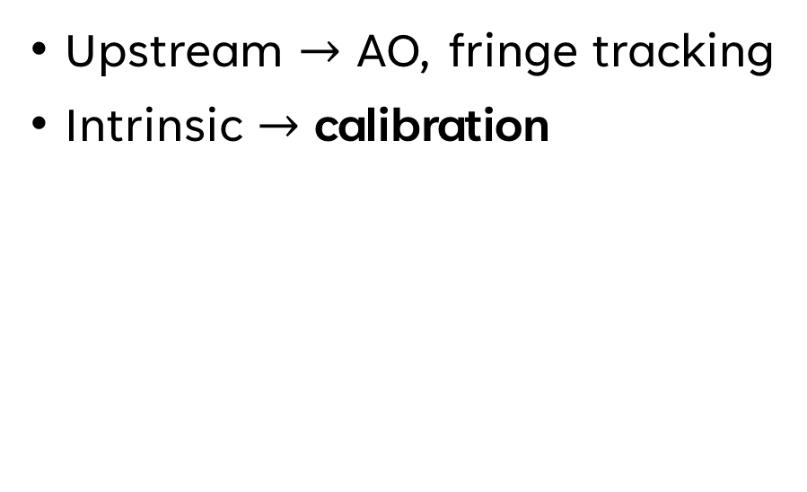
Phase aberration sources
Upstream $→$ AO, fringe tracking
Intrinsic $→$ calibration
statistical analysis

Slide 4
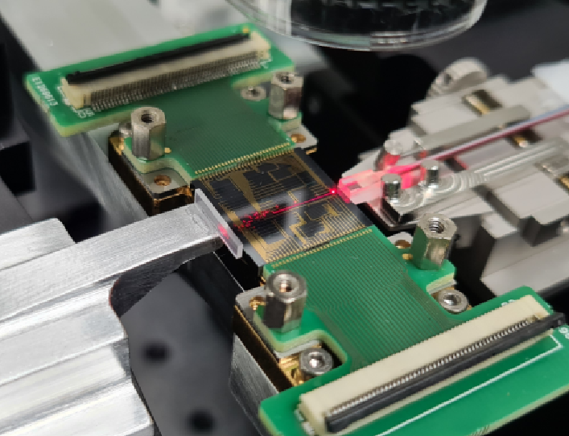
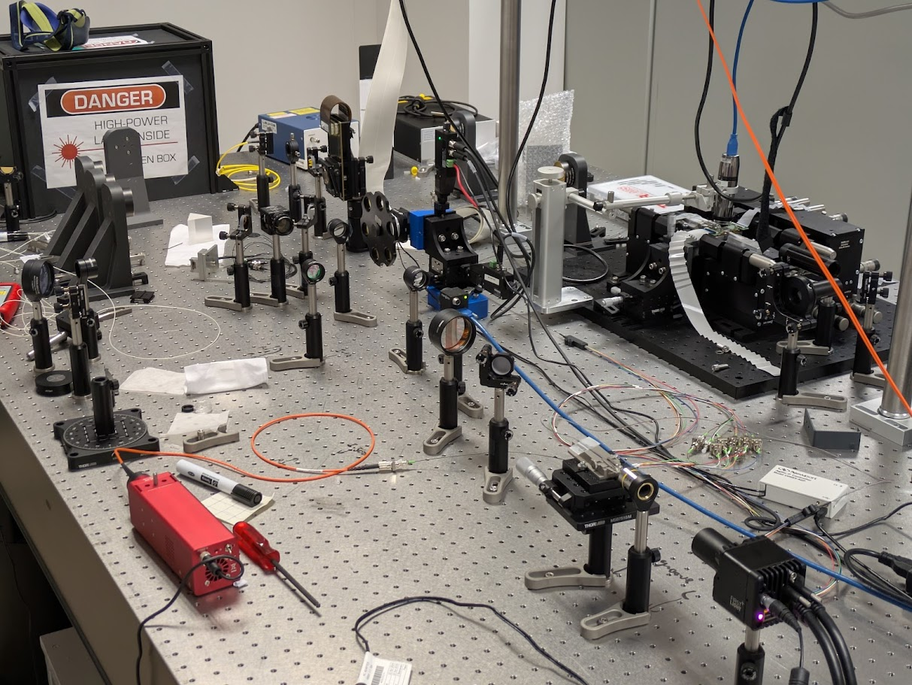

Photonic technology
Photonic chip made of SiN ($16mm$ large)
H band ($λ_{0}=1.55μm$)

Slide 5
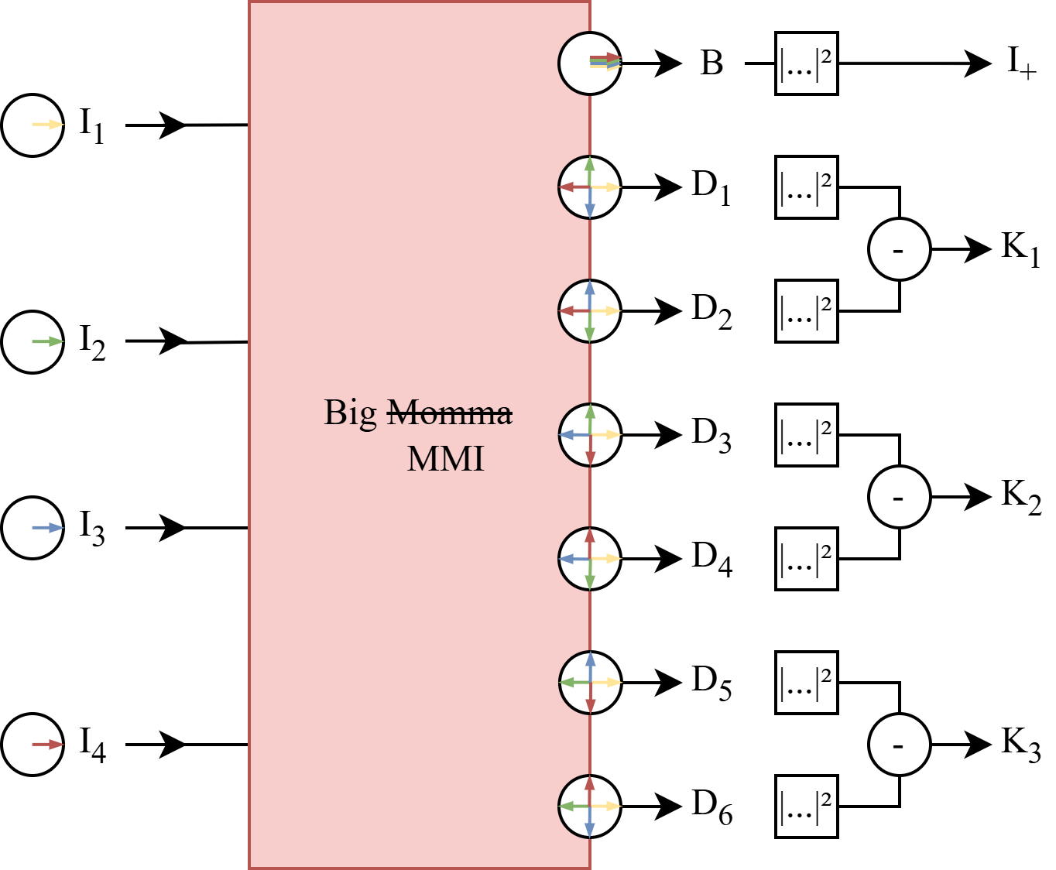
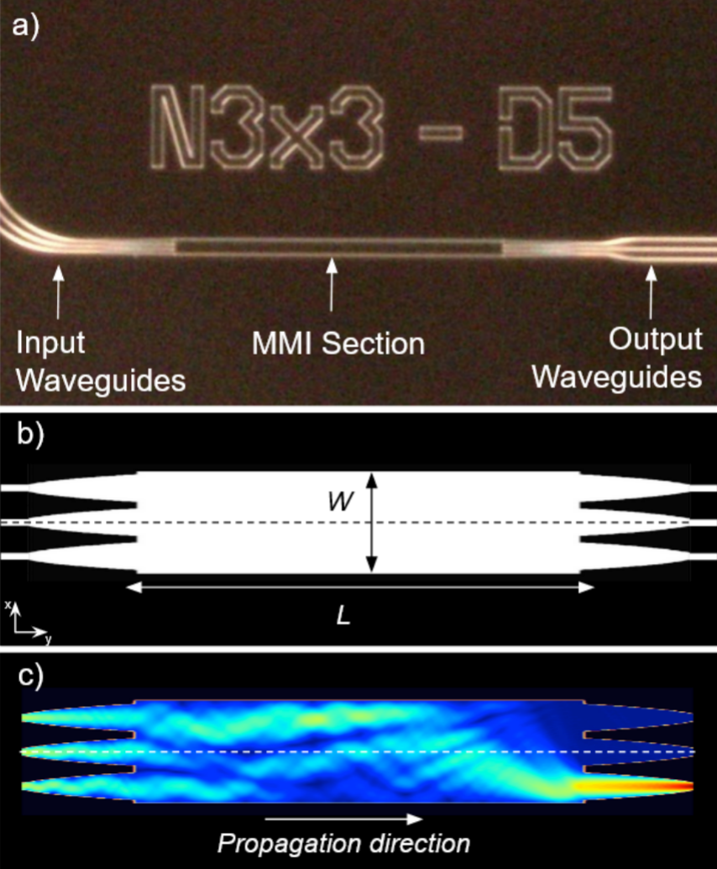
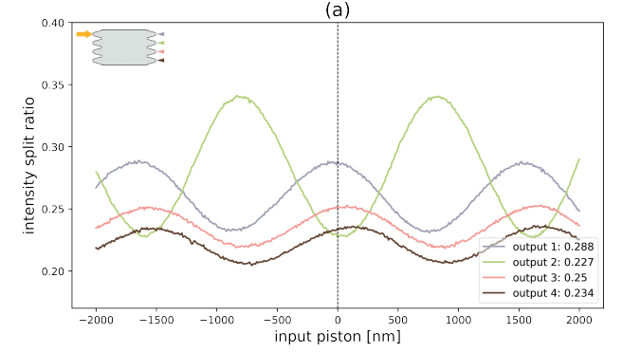
Multi Mode Interferometer (MMI)
Wave propagation simulation in a MMI (Multi Mode Interferometer) 📚 N. Cvetojevic et al. (2022)
Variation of the beam splitting ratio at the outputs of the 4x4 MMI 📚 P. Chingaipe (2024)

Slide 6
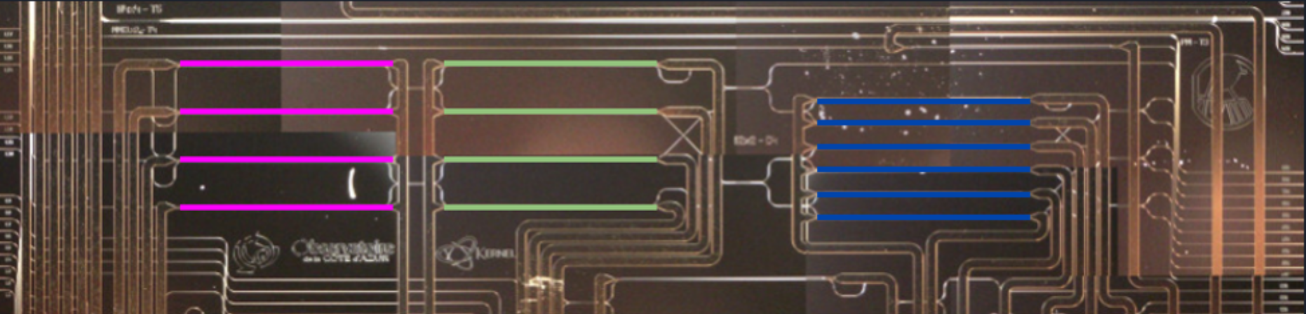
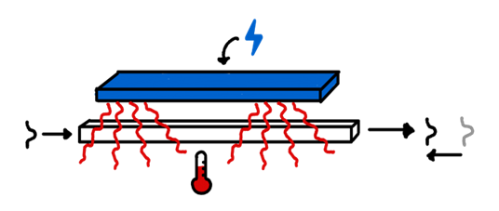
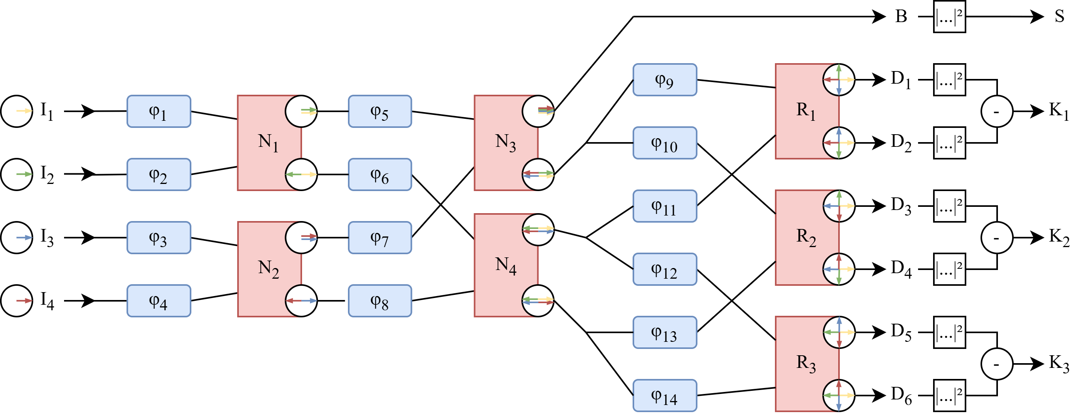
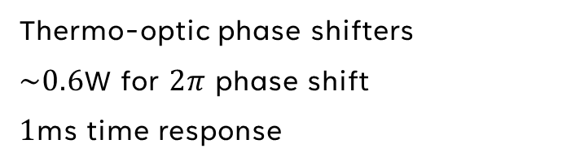
Tunable architecture
Thermo-optic phase shifters
$\sim 0.6$W for $2π$ phase shift
$1$ms time response

Slide 7
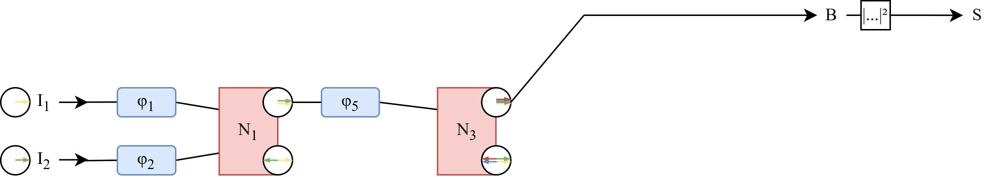
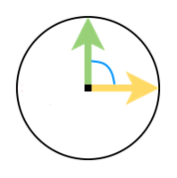
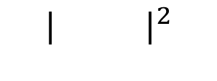
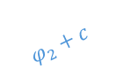
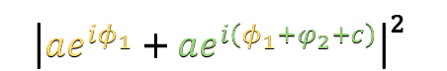
Two calibration approaches
Obstruction
Isolate one MMI
Tweak input relative phase
Deduce right shift to inject from output response
Do it for all MMI
Trial & Error
Add a shift somewhere
Look at the output
Is it better?
Yes: Keep it No: Reject it
Repeat
$$φ_{2}+c$$
$${| |}^{2}$$
$${\left|ae^{iφ_{1}}+ae^{i\left(φ_{1}+φ_{2}+c\right)}\right|}^{2}$$

Slide 8
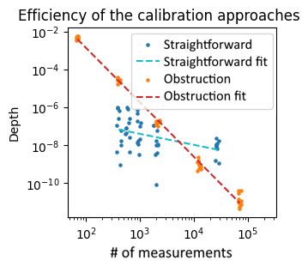
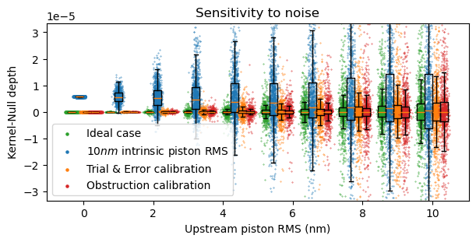
Comparison
Trial & Error
Trial & Error fit
Obstruction
Obstruction fit
?

Slide 9
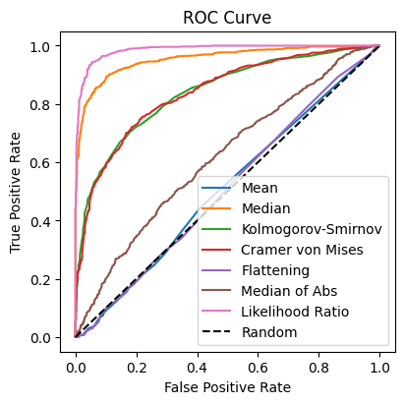
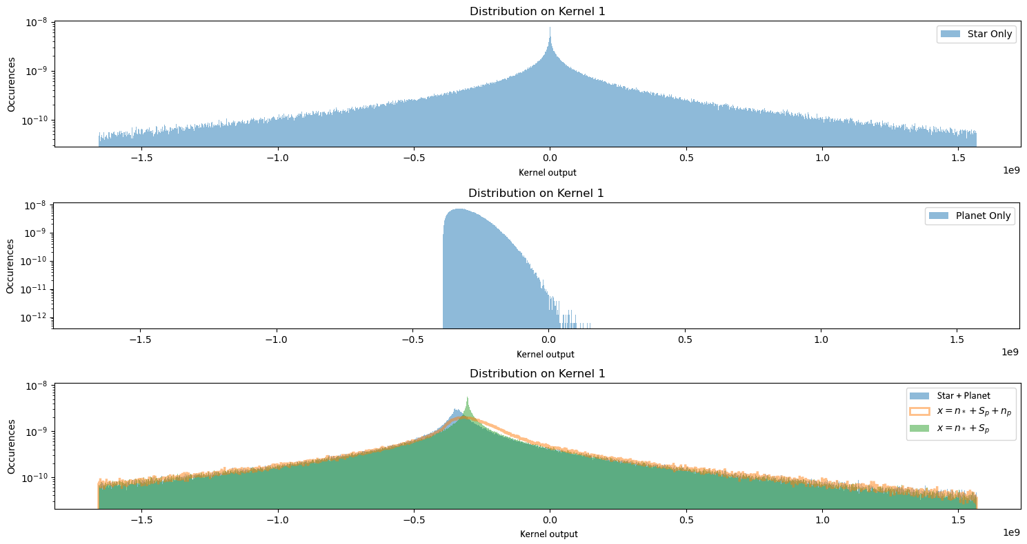
Output data analysis
Kernel outputs follows an unknown distribution
Companion effect is not yet clearly understood

Slide 10
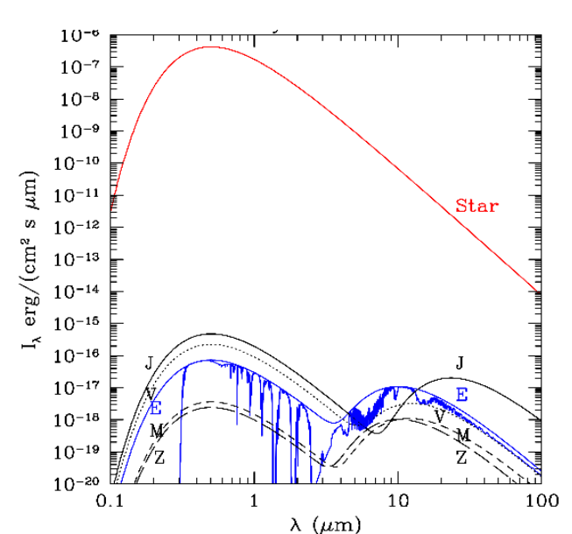
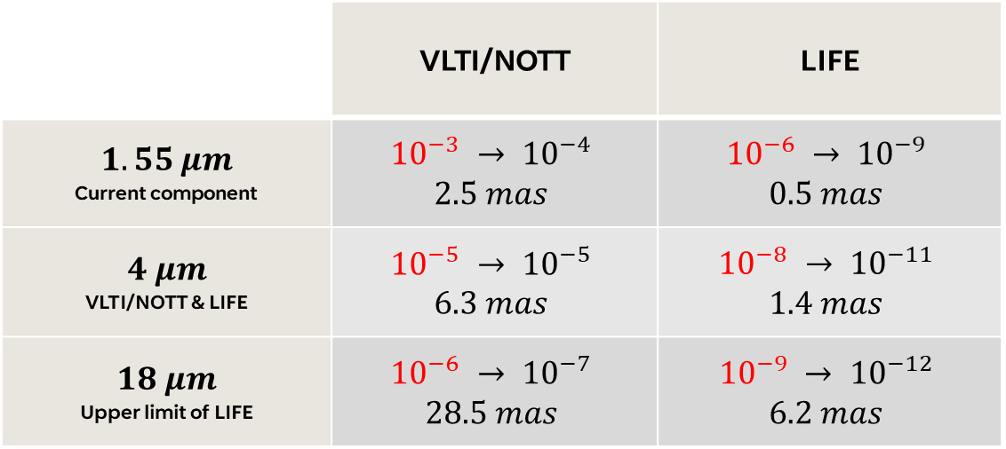
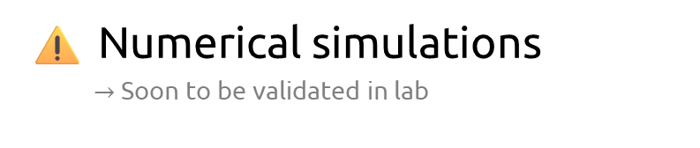
Detection capability
VLTI/NOTT
LIFE
 | VLTI/NOTT | LIFE
$$1.55 μm$$ Current component | $${10}^{−3} → {10}^{−4}$$ $$2.5 mas$$ | $${10}^{−6} → {10}^{−9}$$ $$0.5 mas$$
$$4 μm$$ VLTI/NOTT & LIFE | $${10}^{−5} → {10}^{−5}$$ $$6.3 mas$$ | $${10}^{−8} → {10}^{−11}$$ $$1.4 mas$$
$$18 μm$$ Upper limit of LIFE | $${10}^{−6} → {10}^{−7}$$ $$28.5 mas$$ | $${10}^{−9} → {10}^{−12}$$ $$6.2 mas$$
⚠️ Numerical simulations
$→$ Soon to be validated in lab
SAO model of our solar system 📚 Kaltenegger et al. (2010)

Slide 11
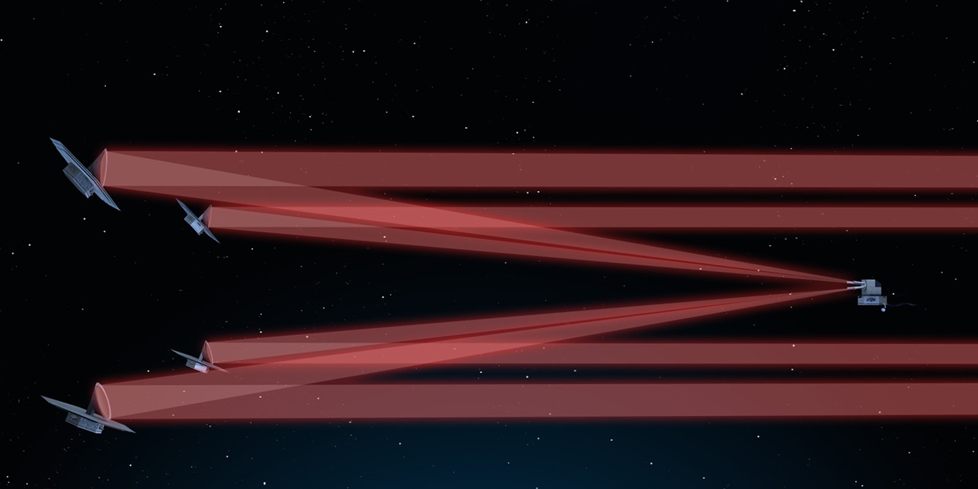
Future Prospects
Conclusion
VLTI/NOTT
LIFE
Compact, stable, light
Possibility to make it almost ideal!
According to the intrinsic aberrations, we can win up to a factor 10 in contrast
Vincent Foriel – LIFE 2025
11

Slide 12
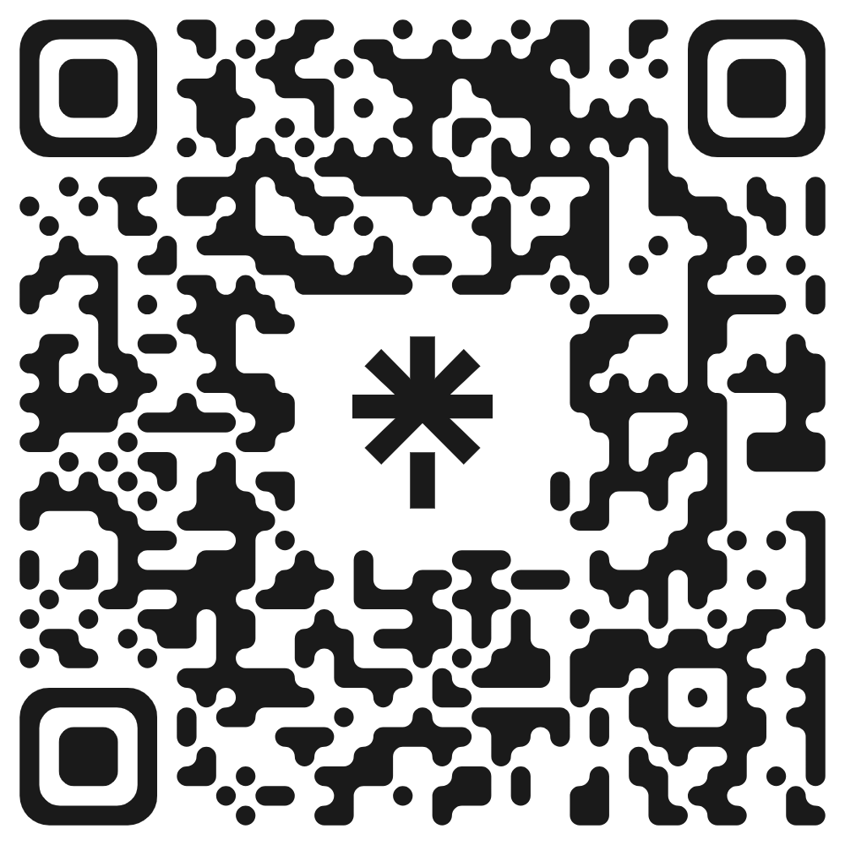
Thank you!
vincent.foriel@oca.eu

